Slide 1






Protein Data Bank in Europe
PDBe.org
Mihaly Varadi
ECCB 2018
Athens, 8th Sep
pdbhelp@ebi.ac.uk
proteindatabank
@PDBeurope
pdbeurope
pdbart

Slide 2
Programmatic search in PDBe

Slide 3
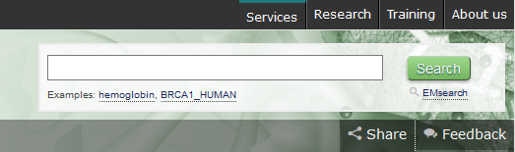
PDBe web search is based on the API
Initial queries typed into autocomplete search bar
Can then refine search by additional queries
These are the facets on the left-hand side
URL contains the queries involved in the search
Directly corresponding to API calls
Notes:
Before we discuss the search API…
Web search feeds nicely into API search

Slide 4
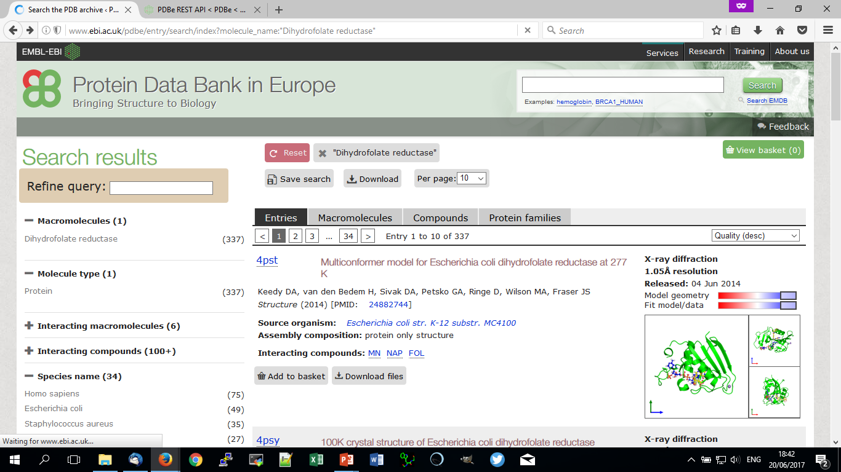
Query = molecule_name:“Dihydrofolate reductase”
http://www.ebi.ac.uk/pdbe/entry/search/index?molecule_name:“Dihydrofolate reductase”
PDBe.org/API
Notes:
Here is an example of a web search
*click when mentioning DHFR*

Slide 5
Query = molecule_name:“Dihydrofolate reductase”
http://www.ebi.ac.uk/pdbe/entry/search/index?molecule_name:“Dihydrofolate reductase”
PDBe.org/API

Slide 6
Query = molecule_name:“Dihydrofolate reductase”
Can narrow by additional facets/queries
PDBe.org/API

Slide 7
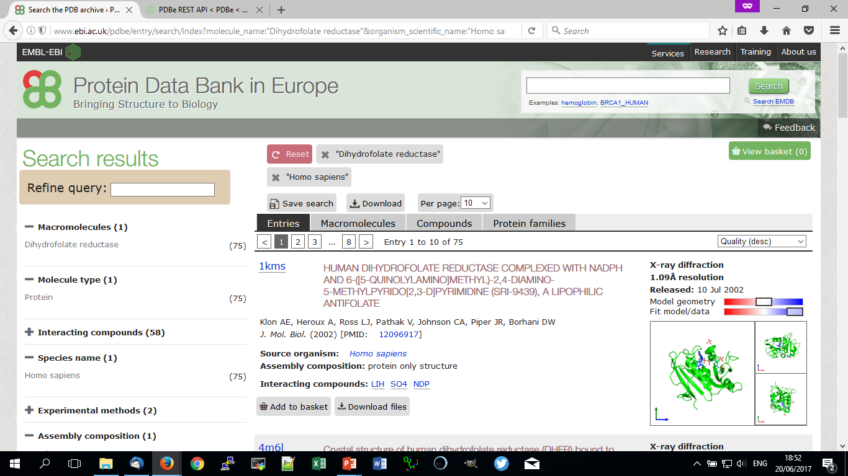
Query = molecule_name:“Dihydrofolate reductase”
http://www.ebi.ac.uk/pdbe/entry/search/index?molecule_name:“Dihydrofolate reductase”&organism_scientific_name:"Homo sapiens”
PDBe.org/API

Slide 8
Query = molecule_name:“Dihydrofolate reductase”
http://www.ebi.ac.uk/pdbe/entry/search/index?molecule_name:“Dihydrofolate reductase”&organism_scientific_name:"Homo sapiens”
PDBe.org/API

Slide 9
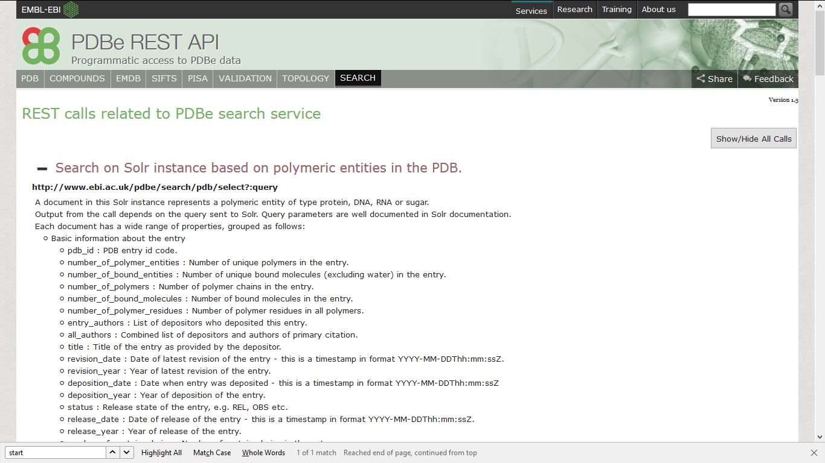
Search in the documentation page
PDBe.org/API
Notes:
Moving on to the API search, using API documentation to demonstrate
Group is ‘Search’ *click*
Also get URL for search API *click*
*Move to next slide for URL description*

Slide 10
Search in the documentation page
URL contains information about the call
Host address
Defining PDBe search API
Always “pdb/select?” for search API
The query given as input
PDBe.org/API

Slide 11
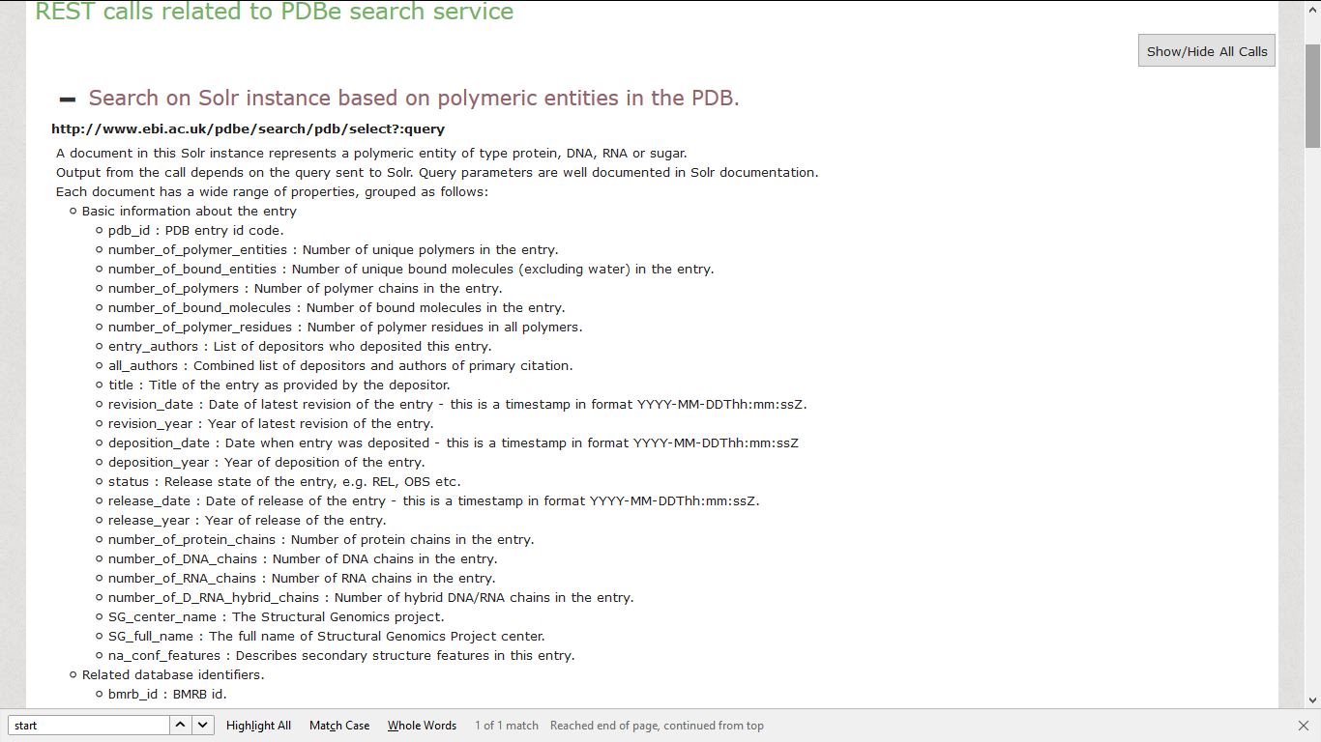
Search in the documentation page
PDBe.org/API
Notes:
List of search queries in documentation, for example…
*click* PDB ID
*click* deposition year

Slide 12
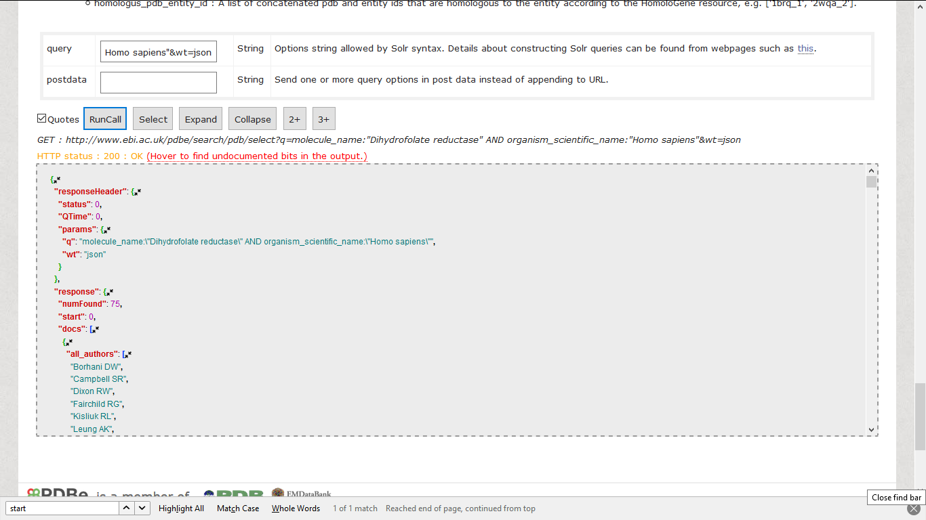
Search in the documentation page
PDBe.org/API
Notes:
Here is the interactive example call for the search documentation
*click* Our search is powered by Solr
*click* Link here to access documentation for building Solr calls

Slide 13
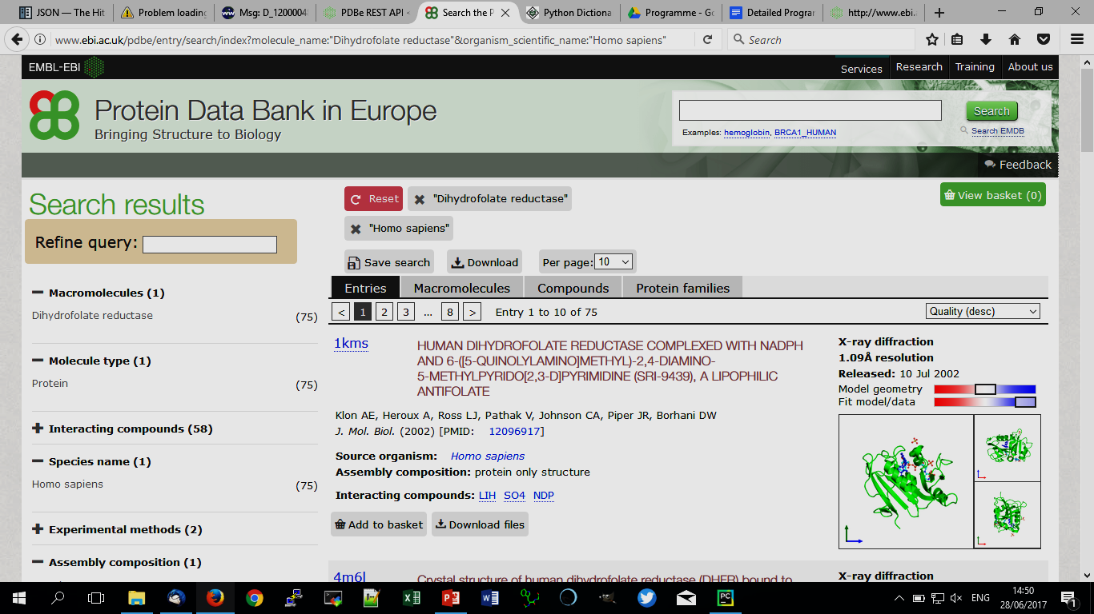
Search in the documentation page
Search API URL differs in linking queries
Uses ‘ AND ’ rather than ‘&’
Otherwise, query terms interchangeable
PDBe.org/API
Notes:
Run same example search as in our web search
URL given back
If we look closer *click* can see queries in same format as web search URL *click*
Significant difference *click* is in the linking of multiple queries
Using word AND enables options for OR and NOT as well.
Still ‘&’ to separate different search parameters, e.g. result format

Slide 14
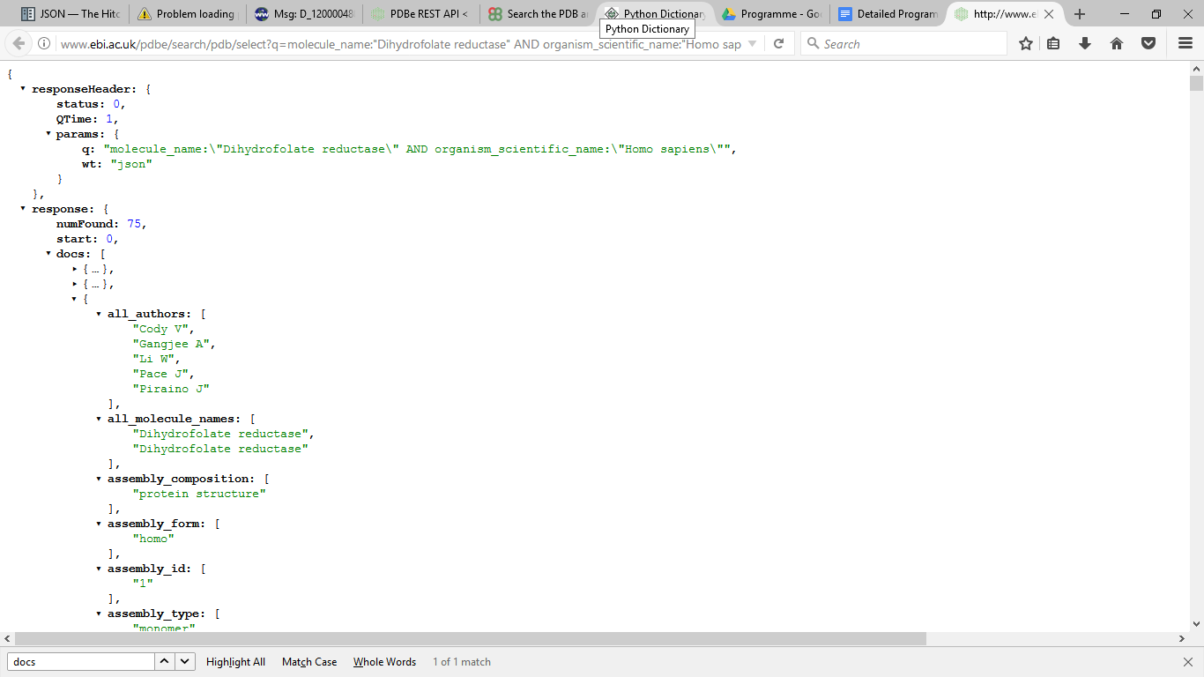
Search in the documentation page
Search results as JSON
Summary in responseHeader
Response gives no. of hits
Results found in docs
Given as dictionary
Values for each parameter
PDBe.org/API
Notes:
ResponseHeader gives status and the search parameters
Parameters show difference in linking types:
Queries contain ‘ AND ‘ while result format, separated in URL by ‘&’ is a separate parameter
Final: for this example, the list of entry authors is shown

Slide 15
PDBe component library

Slide 16
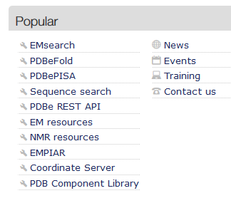
PDB component library
Number of components available for website integration
LiteMol
PDB Links
Sequence feature view
PDB Residue interactions
More details on components page
Find in Popular links at PDBe.org
PDBe.org

Slide 17
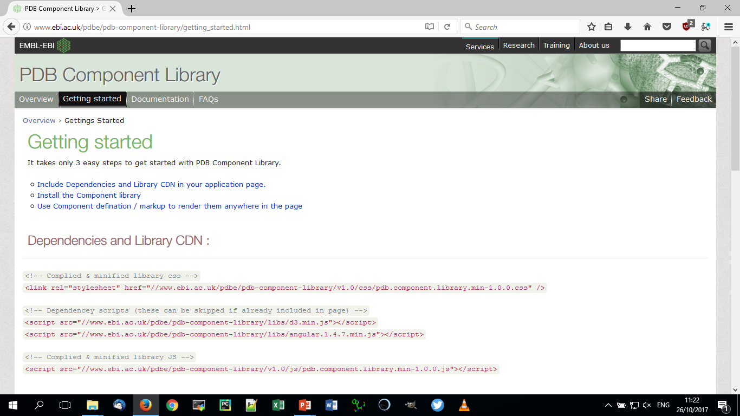
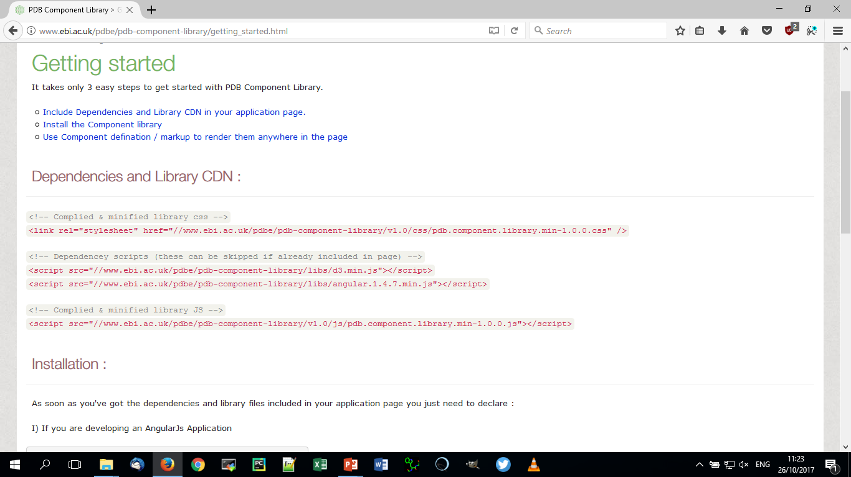
PDBe.org

Slide 18
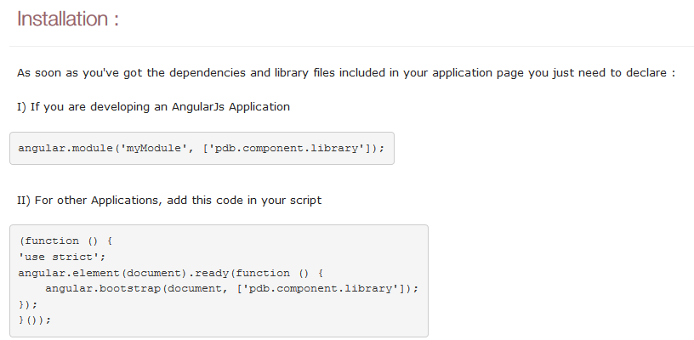
PDBe.org

Slide 19
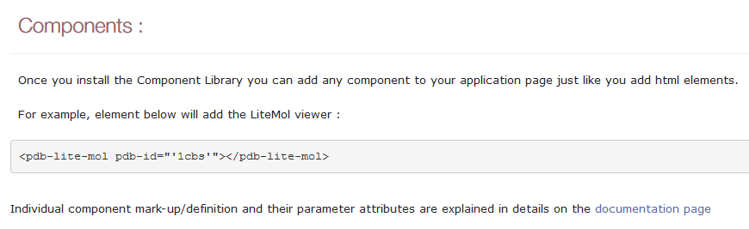
PDBe.org

Slide 20
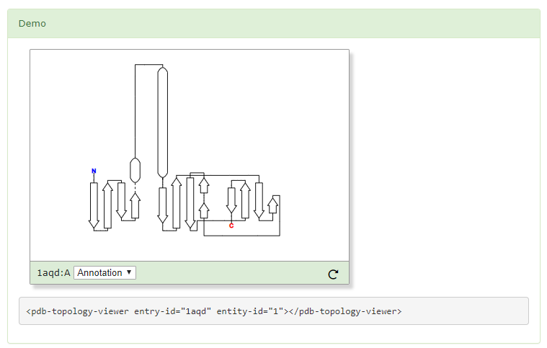
Topology viewer

Slide 21
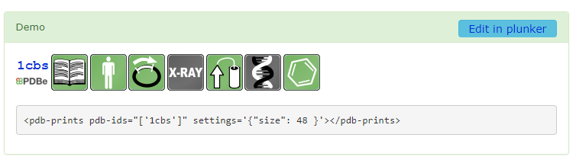
PDB prints

Slide 22
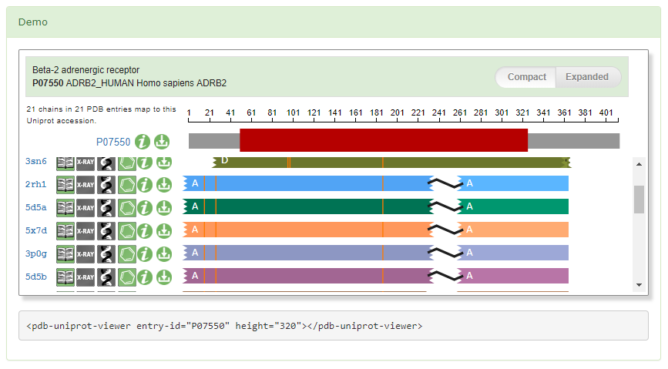
PDB UniProt viewer (UniPDB)

Slide 23
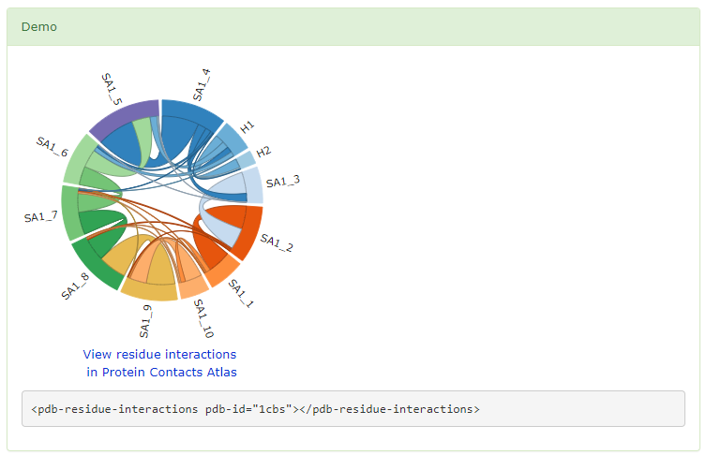
PDB residue interactions

Slide 24
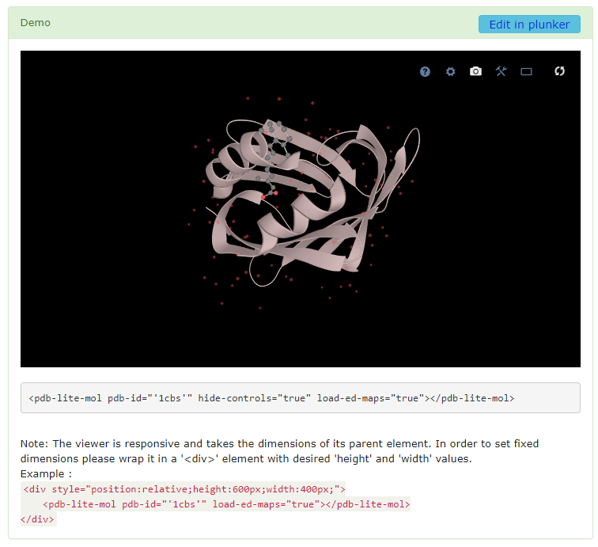

LiteMol
PDBe.org
Notes:
Once component library is installed, just add elements shown at the bottom of the demo.
Documentation page gives instructions to specify parameters

Slide 25
Hands-on part!
https://github.com/uniprot-pdbe/eccb2018/

